Slide 1

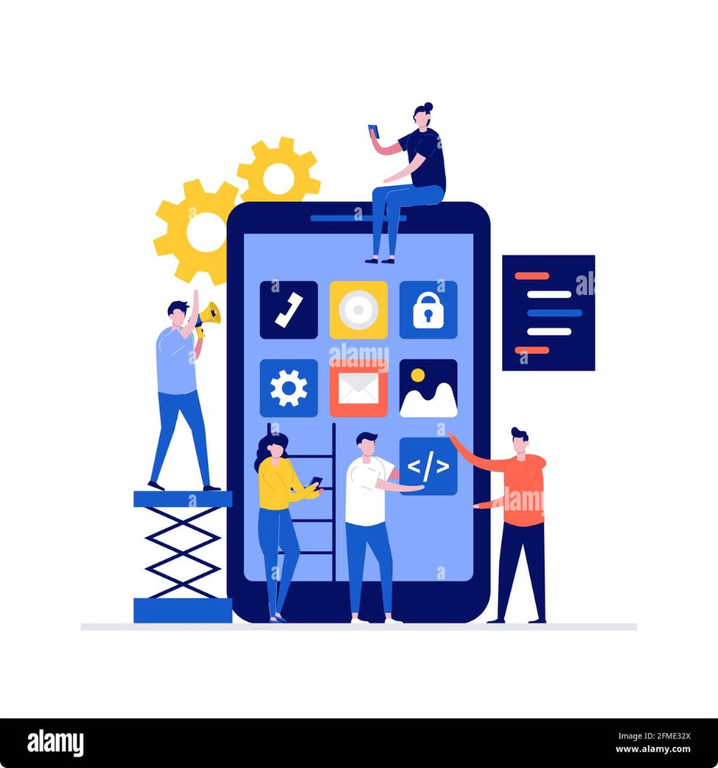
Mobile App Design: Challenges and Strategies
Developing high-quality mobile applications poses unique challenges for software engineers and designers. From navigating the complexities of cross-platform development to optimizing user experiences for small screens, mobile app design requires a specialized skillset and careful attention to emerging trends and best practices. This chapter will explore the key considerations, techniques, and lessons learned in the field of mobile app design, equipping computer science students and professionals with the knowledge to build innovative and user-centric mobile experiences.
PN
by Peter Njathi

Slide 2
Navigating the Mobile Landscape
Development Considerations
Mobile app development requires addressing a wide range of factors, including platform-specific SDKs, device fragmentation, performance optimization, and power management. Developers must carefully design their apps to ensure seamless user experiences across a diverse range of hardware and software configurations.
Context-Aware Design
Designing mobile apps that adapt to user context, such as location, time, and environmental factors, can greatly enhance the user experience. Leveraging sensors and contextual data enables the creation of more personalized and intuitive mobile applications.
1
2
3
Technical Challenges
Mobile devices present unique technical hurdles, such as limited processing power, memory constraints, and the need for efficient data management and battery life. Architects must balance feature-richness with system resource utilization to deliver responsive and energy-efficient mobile apps.

Slide 3
Ensuring Mobile App Quality
Comprehensive Testing
User Interface Design
Lessons Learned
Thorough testing is crucial for mobile app development, encompassing functional, performance, and compatibility testing across a wide range of devices and OS versions. Automated testing frameworks and cloud-based testing services can help streamline the QA process.
Crafting intuitive and visually appealing user interfaces is essential for mobile apps. Designers must consider factors like screen size, gesture-based interactions, and platform-specific design guidelines to create seamless and engaging experiences.
The mobile app landscape is constantly evolving, and developers must stay up-to-date with the latest trends, technologies, and user preferences. Continuous learning, user feedback, and iterative development are key to delivering successful mobile applications.

Slide 4
Embracing Mobile Ecosystems
1
Mobility Environments
2
The Cloud Connection
3
Applicability of Software Engineering
Mobile apps exist within dynamic ecosystems, interacting with various platforms, cloud services, and IoT devices. Developers must understand the nuances of these environments to create apps that seamlessly integrate and leverage the full potential of mobile technologies.
Cloud computing plays a crucial role in mobile app development, providing scalable infrastructure, data storage, and services that enhance the functionality and user experience of mobile applications. Leveraging cloud technologies can help overcome the limitations of mobile devices.
While many conventional software engineering principles and practices apply to mobile app development, the unique characteristics of mobile platforms require specialized approaches. Developers must adapt their methodologies to address the challenges posed by mobile environments.

Slide 5
Designing for the Mobile User
Contextual Awareness
Minimalist Interfaces
Mobile apps should be designed to adapt to the user's context, such as location, time, and environmental factors. By leveraging sensors and contextual data, mobile apps can provide personalized and seamless experiences that cater to the user's needs and preferences.
Mobile screens offer limited space, so mobile app interfaces must be clean, intuitive, and focused on the essential features. Designers should prioritize simplicity, ease of navigation, and responsive interactions to create engaging and efficient mobile experiences.
Multimodal Interactions
Offline Functionality
Mobile devices offer a variety of input modes, including touch, voice, and gesture-based interactions. Incorporating multimodal capabilities can enhance the user experience and make mobile apps more accessible and intuitive for a diverse range of users.
Mobile users often encounter intermittent connectivity or low-bandwidth situations. Designing mobile apps with robust offline functionality, such as data synchronization and caching, can ensure a seamless user experience even in challenging network conditions.

Slide 6




Leveraging Emerging Technologies
Augmented Reality
Artificial Intelligence
Internet of Things
5G Connectivity
Augmented reality (AR) technologies enable mobile apps to overlay digital content and information onto the user's physical environment, providing immersive and engaging experiences. AR can enhance product visualization, navigation, and educational experiences on mobile devices.
Integrating artificial intelligence (AI) and machine learning capabilities into mobile apps can lead to more intelligent and personalized experiences. AI-powered features like voice assistants, image recognition, and predictive analytics can enhance user engagement and productivity on mobile platforms.
The growing ecosystem of IoT devices offers new opportunities for mobile apps to connect, control, and interact with the physical world. Integrating IoT capabilities into mobile apps can enable innovative use cases in areas like home automation, healthcare, and industrial applications.
The rollout of 5G networks is set to revolutionize mobile experiences, offering significantly faster data speeds, lower latency, and enhanced network reliability. Mobile app developers can leverage 5G to enable real-time, data-intensive applications, such as high-quality video streaming, cloud gaming, and remote collaboration.

Slide 7



Designing for the Future of Mobility
Multimodal Interactions
Intelligent Assistants
Ubiquitous Connectivity
As mobile devices continue to evolve, user interactions will become increasingly multimodal, incorporating voice, gesture, and even thought-based controls. Mobile app designers must adapt their approaches to leverage these emerging input methods and create intuitive, accessible experiences.
Intelligent virtual assistants powered by AI and natural language processing will play a crucial role in the future of mobile apps. These assistants can provide personalized recommendations, automate tasks, and offer contextual support, enhancing the overall user experience.
With the advent of 5G and the continued expansion of IoT, mobile apps will seamlessly integrate with a vast network of connected devices and cloud-based services. This interconnectivity will enable new use cases and foster the development of more seamless, responsive, and intelligent mobile experiences.

Slide 8

Designing for Sustainability
Energy Efficiency
Mobile app developers must prioritize energy-efficient design, leveraging techniques like task-offloading, dynamic resource scaling, and battery-optimized algorithms to minimize the impact on device battery life and overall energy consumption.
Sustainable Materials
As environmental consciousness grows, mobile device and accessory manufacturers are increasingly turning to eco-friendly materials, such as biodegradable plastics, recycled metals, and sustainable packaging. Mobile app designers can collaborate with hardware partners to promote sustainable design practices.
Circular Economy
The principles of the circular economy, which emphasize reuse, repair, and recycling, can be applied to mobile app development. Designers should consider the entire lifecycle of mobile apps, from development to eventual retirement, to minimize waste and environmental impact.

Slide 9



The Future of Mobile App Design
Innovative Form Factors
Immersive Interactions
Intelligent Ecosystems
As mobile device hardware continues to evolve, we can expect to see the emergence of more innovative and flexible form factors, such as foldable smartphones, rollable displays, and modular designs. Mobile app designers must adapt their approaches to accommodate these new device capabilities and provide seamless user experiences.
The future of mobile app design will likely feature more immersive and intuitive user interactions, leveraging technologies like holographic displays, advanced haptic feedback, and gesture-based controls. These emerging interaction modalities will enable more natural and engaging mobile experiences.
Mobile apps will become increasingly integrated within a broader ecosystem of connected devices, cloud services, and intelligent algorithms. This interconnectivity will enable mobile apps to provide more personalized, contextual, and adaptive experiences, blurring the lines between the digital and physical worlds.

